Slide 1
Daily Study
2017/01/03
김서진

Slide 2
읽은 논문 리스트
Server Trace Analysis for an Optimal Design of Solid State Drives[IJAER’16] (17/12/05)
Write-off loading: Practical power Management for Enterprise Storage [FAST’08] (17/12/06~)
Don’t Let RAID Raid the Lifetime of your SSD Array [Hotstorage’13] (17/12/11~)
Addressing the Dark Side of Vision Research: Storage [Hotstorage’17] (17/12/21~18/01/02)

Slide 3
Don’t Let RAID Raid the Lifetime of your SSD Array [Hotstorage’13]
Goal
Build a reliability model of SSD based RAID
Motivation
RAID5 could be less endurable because of parity protection
Write amplification is caused by garbage collection, ECC recovery, parity update
Solution
Parity update increases write workload and space utilization which can severely degrade the reliability of SSD arrays

Slide 4
Today 공부한 내용
1.Write Amplification: Garbage collection
NAND flash memory - non-volatile memory (ex. SSD)
A log structured system
Written in a unit of page: 4KB
Erased in a unit of a block: 512KB (bigger than the unit of write)
Does not support in-place update
Internal fragmentation and tidy the fragmented data for GC
Moves valid pages from one place to another for GC
This makes additional writes (W.A)
Dependent for
1. space utilization: SSD is full, GC initiates quicker but less efficient
Still a larger fraction of the blocks(invalid block???) are still alive( invalid block들이 여전히 지워지지 않고 남아있다는 의미??)
2. hotness of data: hot data tends to be more frequently invalidated, GC is efficient when hot workload concentrates on a small portion of data
Hotness data들이 한곳에 모여 있을 수록 GC efficient 하다는 의미?

Slide 5
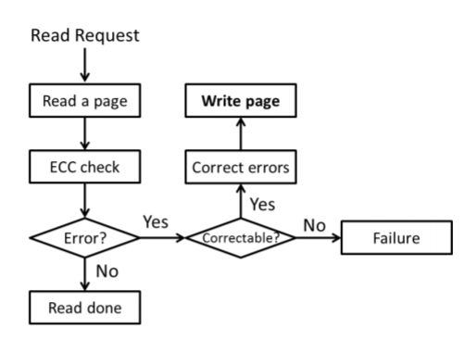
Today 공부한 내용
2. Write Amplification: ECC recovery
ECC: Error Correcting Code(어디서 존재해서 어디로 누가 어떻게 실행하는 code? )
W.A. due to ECC recovery
Reads lead to write
(Write amplification due to ECC on flash memory or leave those bit errors alone, MSST’12 )

Slide 6
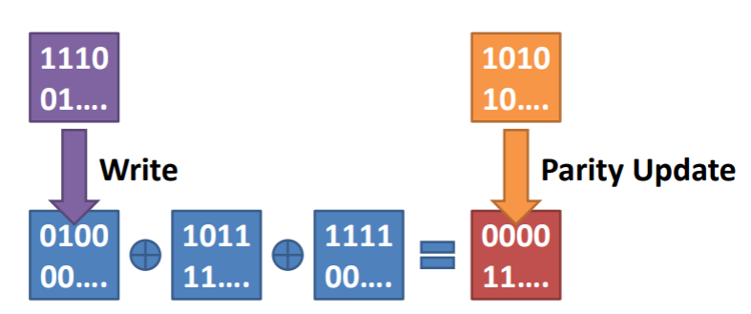
Today 공부한 내용
3. Write Amplification: Parity update(RAID5)
Parity Protection Scheme(RAID5)
정의: protect a device array from a device failure
1. Parity update results in additional writes
because parity block is the result from XOR operation of the data blocks
For a small write: W.A.F=2 -> 이유: the data block & the parity block is updated (WAF=2/1)
For a larger write: W.A.F=N/(N-1) -> 이유: N-1개의 data block이 update되면 parity block 1개도 update되기 때문
Data block이 update되면 parity block도 update되어야 한다.

Slide 7
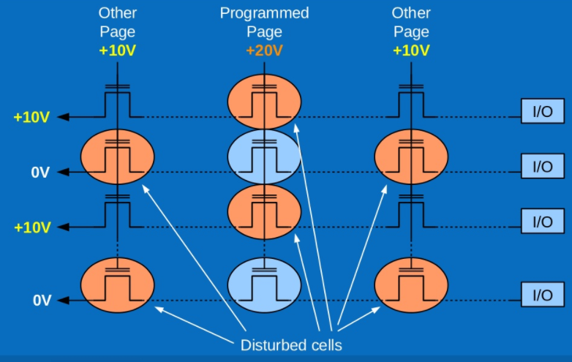
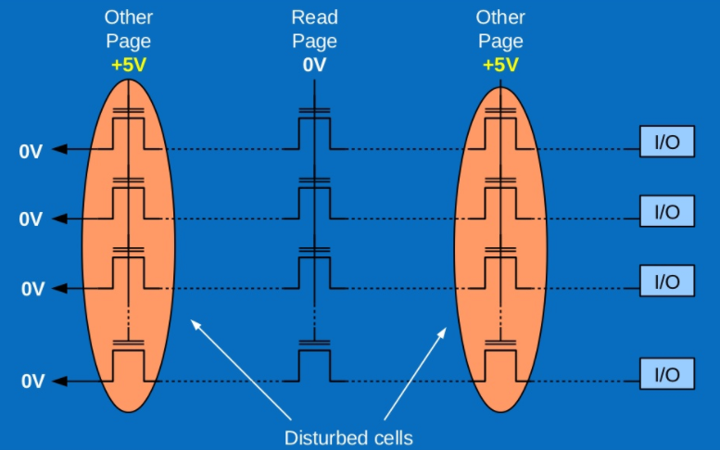
Today 공부한 내용
MLC bit error behavior of flash memory
Read disturb(per read): cells not being read receive elevated voltage stress
Data retention failure(per month): charge loss/gain occurs on the floating gate over time
Write error(per write) : 찾아도 명확한 설명이 안나옴
(The Inconvenient truths for NAND Flash Memory , Flash Memory Summit’07)
Notes:
참고자료: https://cushychicken.github.io/assets/cooke_inconvenient_truths.pdf
https://www.slideshare.net/ennael/dwmw2-kr201209

Slide 8
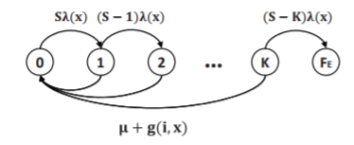
Today 공부한 내용
Markov model of page error rate
Markov model:은닉 마르코프 모델은 시간의 흐름에 따라 변화하는 시스템의 패턴을 인식하는 작업에 유용하다.
Markov model of page error rate
Probability(S1->S2)
S1
S2
Probability(S2->S1)
S: the number of bits in a page
K: the number of correctable bits by ECC per page
FE: (state) page error: ECC cannot recover the page(복구 불가능한 상태)
λ(x) : raw bit error rate
µ: page access rate (이거는 왜지? 무슨 page access ? ECC가 page에 access 하는 rate인가??)
g(i, x) : garbage collection access rate

Slide 9
Today 공부한 내용
SSD Parameters
3x nm MLC flash memory (3x nm 이 의미하는 것? )
Capacity = 80GB (왜 capacity 80GB??)
Page size=4KB
ECC: 61-bit errors correctable BCH code (왜 61bit, BCH)
Annual device failure rate=3%
TRIM command is exploited
TRIM: OS가 어느 블록의 데이터가 더 이상 사용되지 않고 내부적으로 삭제될 수 있는지 SSD에 알려주는 명령어이다.
Simulation Parameters
The amount of data = 30GB/SSD (GC 영향 최소화?)
Workload
Read+Write = 125MB /s/SSD
Read:Write = 3:1 (왜?) 125/1(MB/s/SSD) : 125/3(MB/s/SSD) ?????
8 SSDs in an SSD array

Slide 10
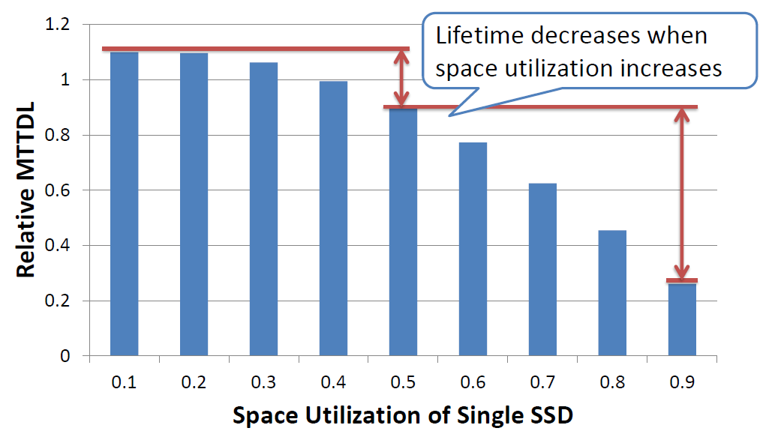
Today 공부한 내용
Relative MTTDL
The ratio of the lifetime of the target SSD array to that of single SSD with default parameters – 어떤 부분을 실험에서 변경하는지 뒤에서 확인
왜 0.5 기준으로 뒤로 갈수록 lifetime이 급격히 감소하는지?
70%감소
SSD의 space utilization을 어떻게 변경하지?
Space utilization의 정의: used storage capacity/target storage capacity

Slide 11
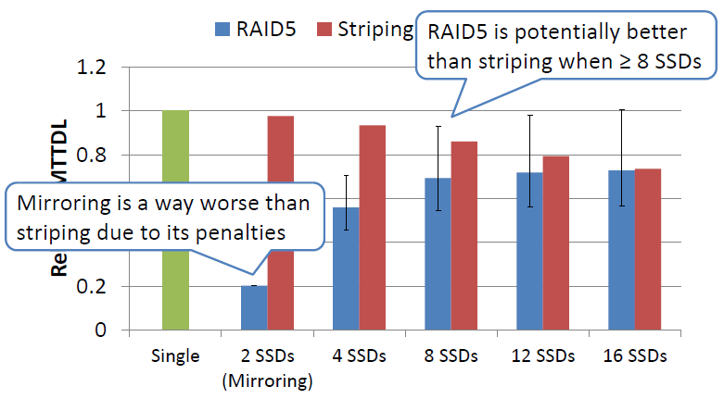
Today 공부한 내용
Lifetime of different number of SSDs
왜 Mirroring?

Slide 12
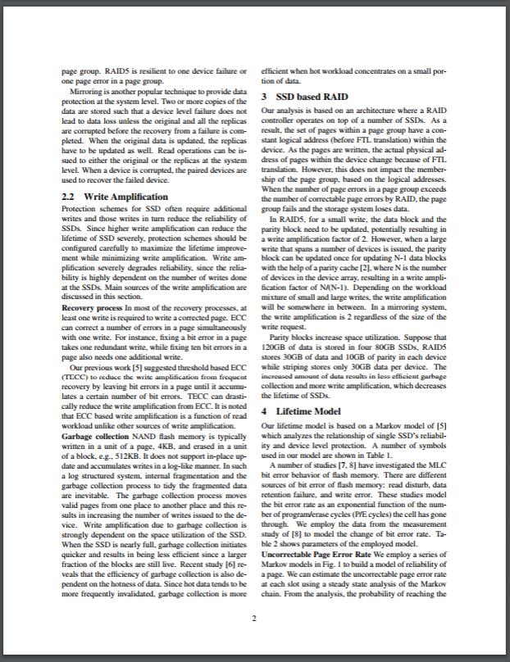
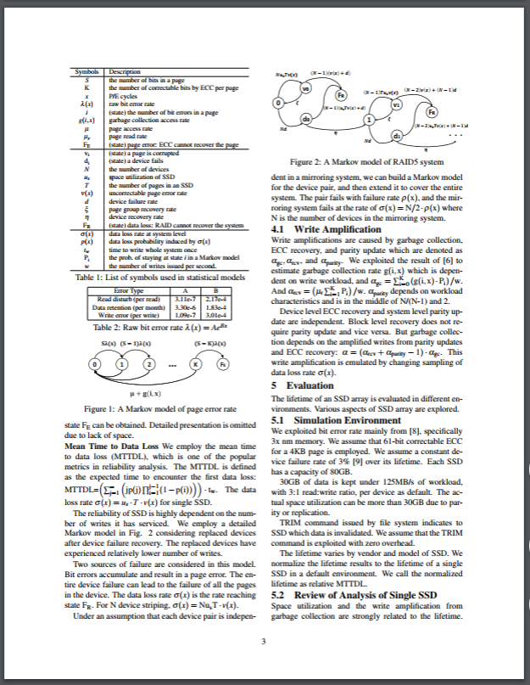
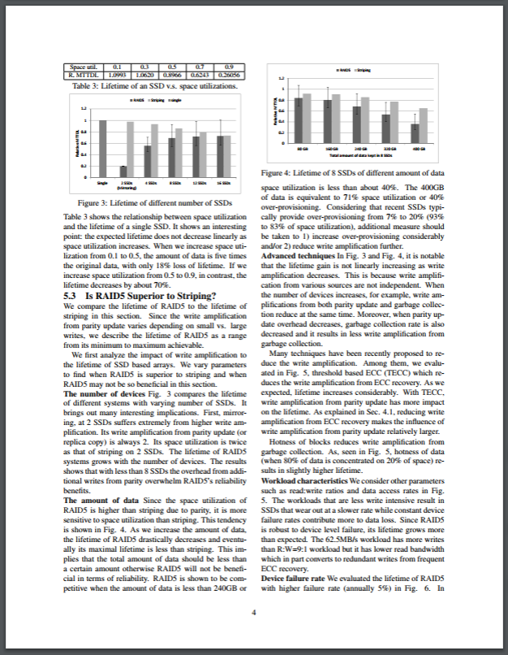
Today 공부한 내용
2p 3p 4p

